Slide 1

Results
2025
[Prévia enviada em 06/02]

Slide 2
HIGHLIGHTS

Slide 3
HIGHLIGHTS
2025 marks the beginning of a new cycle of high profitability, supported by the disciplined execution of our strategy, the consolidation of a diversified model across multiple credit lines, and an increasingly efficient capital allocation.
In Collateralized Retail, we have consistently advanced with the consolidation of private payroll loans and the expansion of payroll and benefit cards. Digital, collateralized, and scalable products have expanded our client base, increased profitability, and reinforced operational efficiency, supported by data and technology. Strategic moves in our invested companies have simplified the corporate structure and strengthened cash generation.
In Wholesale, we maintained a selective approach to corporate credit, preserving the quality of our portfolio and originating attractive capital allocation opportunities. Derivatives, insurance, and Capital Markets gained scale, expanding cross-selling, revenue recurrence, and our origination and distribution capacity.
Throughout the year, we diversified our funding sources, reduced our cost of funding, and advanced in technology, data, and AI. We ended 2025 stronger, more efficient, and well-positioned to sustain this new cycle of profitability and value generation.

Slide 4



HIGHLIGHTS
NET INCOME
ROE¹
R$
R$
183.5 mn
443.6 mn
54.8%
33.4%
4Q25
2025
4Q25
2025
+ 173% vs. 4Q24
+ 72% vs. 2024
+ 32.6 bps vs. 4T24
+ 10.5 bps vs. 2024
RECURRING NET INCOME
RECURRING ROE¹
R$
R$
119.5 mn
379.6 mn
36.6%
29.3%
4Q25
2025
4Q25
2025
+ 78% vs. 4Q24
+ 47% vs. 2024
+ 14.4 bps vs. 4T24
+ 6.4 p bps. 2024
FUNDING
REGULATORY CAPITAL
BASEL INDEX
CREDIT PORTIFOLIO
R$
R$
R$
15.0%
17.7 bn
21.2 bn
2.2 bn
Dec/25
Dec/25
Dec/25
Dec/25
+ 0.5 bps. vs. Dez/24
+ 24% vs. Dec/24
+ 21% vs. Dec/24
+ 29% vs. Dec/24
1 – ROAE 4Q25 = (Earnings 4Q25*4 / Average Equity between Sep/25 and Dec/25); ROE 2025 = (Earnings 2025* / Average Equity between Dec/24 and Dec/25).
Rating: ‘brA+’
Perspective: Stable
Rating: ‘A’
Perspective: Positive
4

Slide 5
Our
businesses

Slide 6
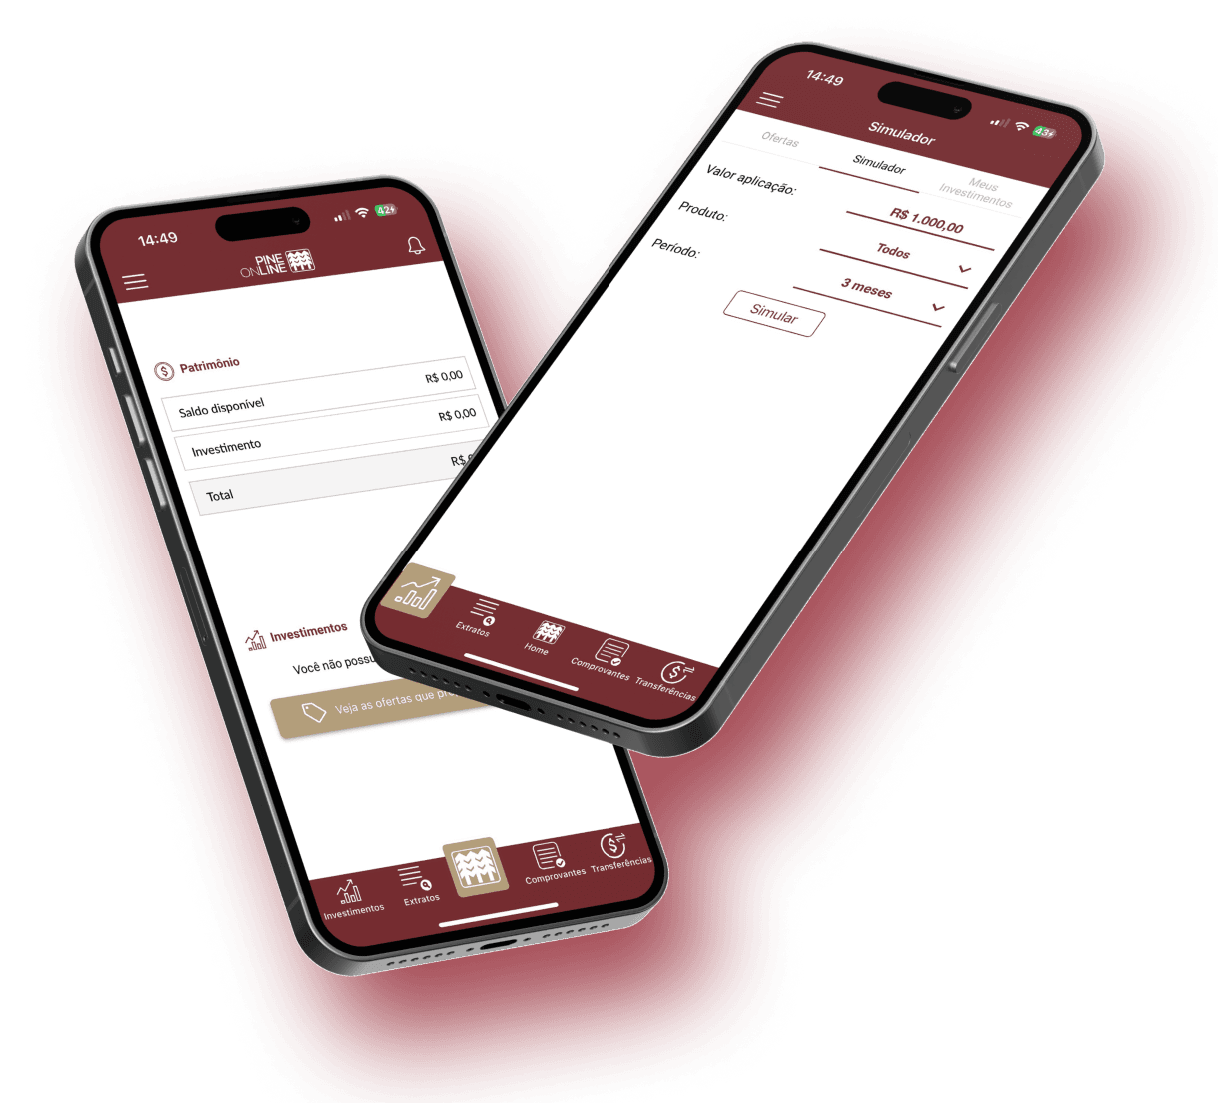

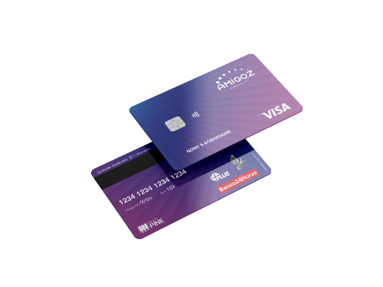





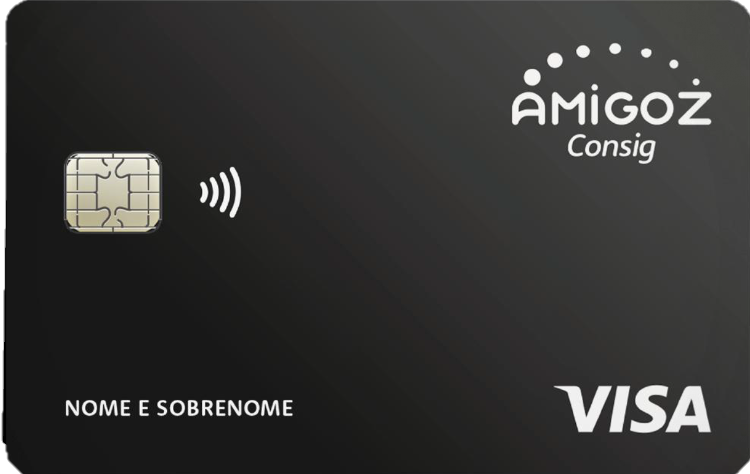
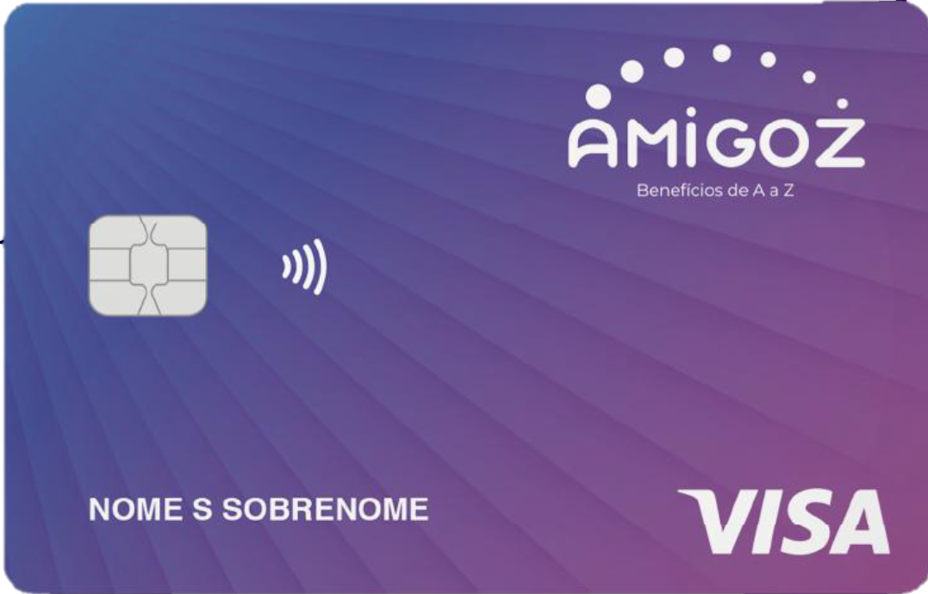



Our businesses
Collateralized Retail
Wholesale
Private Payroll
Payroll Loans
Corporate
Client´s Trading Desk
(Derivatives and Foreign Exchange)
Capital Markets and Structured Transactions
Public
Payroll Loans/Credit Cards
INSS
FGTS
Public Entities
Insurance (Retail and Wholesale)
Pine Corretora
Retail
Benefits
Elementary Branches
Risks
Treasury and Funding
Asset and Liability Management (ALM)
Banking and trading books
Distribution
Pine Online

Slide 7
Credit portfolio

Slide 8


Credit portfolio
The portfolio growth is aligned with our strategy of revenue diversification and optimization of capital allocation.
Portfolio
(R$ mn)
Expanded Portfolio Distribution
(Per volume – Dec/25)
17.051
17.709
14.289
15.411
15.591
Private Payroll Loan
Public Payroll Loan
1.227
1.005
885
472
514
2%
Agribusiness
2%
dec-24
mar-25
jun-25
sep-25
dec-25
2%
Others
3%
Real Estate
Large Corporate
Public Payroll Loan
Services
Logistics & Transportation
Middle Market
Private Payroll Loan
Commerce
Delinquency exceeding 90 days¹ and NIM
(%)
Operations and Coverage Ratio Stage 3²
(%)
109%
107%
122%
115%
WHOLESALE
3,8%
3,9%
4,1%
3,9%
COLLATERALIZED
RETAIL
dez-24
mar-25
jun-25
set-25
dez-25
1T25
2T25
3T25
4T25
1 – Default rate = (Overdue balance > 90 days, excluding 100% provisioned operations) / (Expanded Credit Portfolio); 2 – Portfolio balance in Stage 3 (Central Bank Resolution 4,966) / Expanded Credit Portfolio; 3 – Provision balance / Stage 3.
Distribuição por Prazo Médio
(Por volume – Jun/25)
Inadimplência >90 dias Recorrente⁴
> 3 anos
Até 3 meses
5%
de 3 a 12 meses
5%
(%)
de 1 a 3 anos

Slide 9
Collateralized retail

Slide 10
Collateralized Retail
This period was marked by a portfolio remix, focusing on products with higher spreads and added value.
Portfolio
(R$ mn)
R$ 4,9 bn 46% Yield Roadmap²
9.765
10.584
10.570
INSS
9.340
Private
8.308
Payroll Deduction Cards¹
FGTS
Collateralized Instruments
Governments and Municipalities
Siape
Other entities
379
502
Yield Roadmap
271
309
339
193
362
171
408
424
633
331
Dec-24
Mar-25
Jun-25
Sep-25
Dec-25
Highlights of 2025
Greater diversification and advancement of Collateralized Retail, portfolio remix, and pioneering positioning in Private Payroll Loans, which boosted the profitability of this business with over 3 million clients and we operate with over 100 public entities.
Highly scalable payroll loan market, with an addressable audience of nearly 100 million people among public servants, CLT employees, and INSS beneficiaries. Private payroll loans already total over R$ 100 billion, with potential scale comparable to the public employee market (portfolio exceeding R$ 380 billion).
The payroll loan card portfolio¹ surpassed R$ 813 million, with more than 200,000 clients and a 162% YoY growth in proprietary origination, reflecting the efficiency gains of the digital pipeline and the intensive use of data and technology.
Consistent expansion of Private Payroll Loans, a 100% digital, collateralized, and scalable product, operated on proprietary pipelines and with attractive risk-adjusted profitability. The customer base is evolving and already has more than 1.4 million clients.
Strategic restructuring of the public payroll loan portfolio, after securitizations and portfolio remix, creating avenues for growth with higher profitability.
Progress in cross-selling and product integration, strengthening the integrated model and comprehensive, long-term relationship with our customers.
1 – Benefit and Payroll Deduction Cards originated and acquired.
1 – Cartão Benefício e Consignado originado.
1 – Cartão Benefício e Consignado originado.
1 – Cartão Benefício e Consignado originado.

Slide 11
RETAIL
INVESTMENTS

Slide 12
RETAIL INVESTMENTS
Pine Holding – Retail Reorganization Completed, with Total Focus on Scale and Profitability
Full Exit from BYX and Consolidation of 99.8% of AmigoZ – Jan/26
Payroll Deduction Cards as the Main Driver of Scalable Growth
Recurring and Low-Risk Vertical
Receipt of Additional AmigoZ Quotas
AmigoZ – Total Share Pine Holding – 99.84%
Benefit Card and Public and Private Payroll Deduction Credit Card
Equity Method Result – AmigoZ
(R$ mn)
Fintech dedicated to its own origination of collateralized retail transactions.
Focused on multiple channels.
Public and private partnerships.
+431%
jun-24
set-24
dez-24
mar-25
jun-25
Multiple Avenues of Growth
Payroll Deduction Credit Cards as a Scalable Growth Vertical
Partnerships with retailers to offer discounts on selected products, increasing the attractiveness of the card, frequency of use and customer engagement, without increasing exposure to credit risk.
Incentives focused on expanding the use of the available payroll deduction margin for purchases, boosting transactional volume and monetization, without incremental credit risk.
When linked to the current account, the cards can offer additional unsecured credit limits, allowing incremental growth beyond the regulated payroll deduction margin, preserving risk discipline.
Improved access to payroll deduction credit limits, driven by the evolution of margin processing platforms, enhancing the user experience and utilization within regulatory limits.
4T24
1T25
2T25
3T25
4T25
Pine Holding – Reorganização do Varejo Concluída, com Foco Total em Escala e Rentabilidade
Saída integral da BYX e consolidação de 99,8% da AmigoZ – jan/26
Cartões Consignados como Principal Vetor de Crescimento Escalável
Vertical recorrente e de baixo risco
Recebimento de quotas adicionais da AmigoZ
Conclusão da transação (aquisição de mais 11,98% da AmigoZ, elevando a participação para 99,8%) – jan/26
Expansão de Uso e Monetização sem Aumento de Risco de Crédito
Parcerias com varejistas, incentivos à utilização da margem e maior frequência transacional
Oferta de Crédito Incremental com Disciplina de Risco
Limites adicionais “clean” via integração com conta corrente
Plataforma em Evolução para Sustentar Crescimento
Melhoria contínua no processamento da margem e na experiência do cliente

Slide 13
Wholesale Corporate Credit

Slide 14
WHOLESALE
A period marked by growth focused on structured operations with solid guarantees and in resilient sectors.
Wholesale Sector Distribution
(Per volume – Dec/25)
Distribution by Product
(Per volume – Dec/25)
Paper and Pulp
Agricultural Inputs
Sugar and Ethanol
4%
Others Agri
Protein
3%
4%
Real Estate
Working Capital
Private Securities
Trade Finance
Grains
Real Estate Finance
Finance
Logistics & Transportation
Financial transfers
Others
Infra
1%
Telecom
Commerce
Industry
Warranty Coverage
(%)
Cross-sell
Capital Markets
12%
13%
6%
+Rentability
Investiments
PPI ¹ index
2.4 products
Derivatives + Foreign Exchange
Insurance
Large Corporate
Wholesale
Middle Market
Credit
+Products
Clean Portfolio
Collateralized Portfolio
1 - Penetration Index by product. - (% of customers per number of products contracted.)

Slide 15
WHOLESALE
customer desk and
service provision

Slide 16
WHOLESALE
Consistent results for the quarter, contributing to revenue diversification.
Client´s Trading Desk - 2025
Revenue Breakdown
(Per volume – 2025)
R$28.1 billion notional value of derivatives
R$22.3 billion in foreign exchange traded
+239 active clients
FX
Currency
Commodities
Evolution of Revenue from Services Rendered
(R$ mn)
4Q24
1Q25
2Q25
3Q25
4Q25
2024
2025
1T24
3T23
4T23
1T24
2T24
3T24
9M23
9M24

Slide 17
Capital markets

Slide 18
Capital markets
R$ 4.4 billion in issuances and structuring in 2025
Financial debenture of R$ 1 billion backed by CCBs with payroll deductions, with Itaú BBA as lead coordinator.
RIF of R$ 1 billion backed by CCBs with INSS payroll deductions, with Santander as lead coordinator.
Financial debenture of R$ 1 billion backed by CCBs with INSS payroll deductions, with XP as lead coordinator.
RIF of R$ 1.2 billion backed by CCBs with INSS payroll deductions, with Itaú BBA and XP as lead coordinators.
RIF of R$ 173.4 million backed by CCBs of INSS Benefit Payroll Deduction Card Withdrawal Terms, with Banco Daycoval as lead coordinator.
1T24
3T23
4T23
1T24
2T24
3T24
9M23
9M24

Slide 19
Capital markets
Issuances | Guarantees | Senior | Mezzanine | Subordinated
Debentures – Financial Issuance of ~R$ 1.5 billion | Payroll‑deducted CCBs | 80.00% | - | 20.00%
 | Payroll‑deducted CCBs (INSS) | 100.00% | - | -
FIDC ~R$ 1.0 billion | Payroll‑deducted CCBs (INSS) | 85.00% | 10% Mezzanine Series A 4% Mezzanine Series B | 1.00%
FIDC ~R$ 1.2 billion | Payroll‑deducted CCBs (INSS) | 85.00% | 10.5% Mezzanine Series A 3% Mezzanine Series B | 1.50%
FIDC ~R$ 173.4 million | CCBs from Payroll‑Deducted Benefit Card Take‑Up Terms (INSS) | 85.00% | 11% Mezzanine Series A 1.75% Mezzanine Series B | 2.25%
~R$ 4 billion in Issuances and Structuring in 2025

Slide 20
Funding and capital

Slide 21
Diversificação
Funding AND capital
Diversification of funding and asset and liability management, with capital strengthening to support the expansion of our business.
Volume
(R$ mn)
20.202
20.430
21.218
Diversificação
17.823
18.521
Letras Financeiras²
R$ 1,3 bilhões em Dez/25, +110% vs. Dez/24
Debêntures Financeiras
R$ 2,0 bilhões em Dez/25, +121% vs. Dez/24
CDB
R$ 14,1 bilhões em Dez/25, +18% vs. Dez/24
LCI l LCA
R$ 2,0 bilhões em Dez/25, +63% vs. Dez/24
83
92
69
78
Dec-24
Mar-25
Jun-25
Sep-25
Dec-25
CDB
LCI l LCA
CDI
Capital Markets
Others ¹
Funds Raised by Term
Evolution of the Basel Index
(R$ mn and %)
>3 years
< 3 months
15,0%
14,5%
Positive GAP of 3 months
R$ 2.8 billion in free cash flow
LCR⁴ of 345%
NSFR⁵ of 183%
10,6%
11,3%
3-12 months
Basel Index
Tier I
1-3 years
Dec-24
Dec-25
1 – Other includes Deposits (demand and interbank) and DPGE; 2 – Includes Subordinated Financial Bills; 3 – Short-Term Liquidity Ratio; and 4 – Structural Liquidity Ratio.
Segundo nossas melhores estimativas, os efeitos combinados da implementação da Resolução 4.966 representam um impacto no capital de aproximadamente -0,27 p.p. em janeiro de 2025.

Slide 22
Financial performance

Slide 23
Financial performance
Growth in all operational indicators reflects progress in strategy execution, diversifying our businesses and allocating our capital even more efficiently
Net Profit and ROE¹
(R$ mn and %)
Operational Result
(R$ mn)
33,4%
54,8%
443,6
183,5
119,5
4Q24
1Q25
2Q25
3Q25
4Q25
2024
2025
4Q24
1Q25
2Q25
3Q25
4Q25
2024
2025
Net Profit
ROE
Non-recurring
net profit
Non-recurring ROE
Revenue Breakdown
(%)
Operating Expenses
(R$ mn)
294,6
77,9
86,2
232,4
39%
30%
27%
48%
36%
65,0
62,0
68,5
58%
57%
42%
43%
61%
70%
73%
52%
64%
4Q24
1Q25
2Q25
3Q25
4Q25
2024
2025
4Q24
1Q25
2Q25
3Q25
4Q25
2024
2025
Wholesale
Retail
Administrative Expenses
Personnel Expenses
Efficiency Index
1 – ROAE 4Q25 = (Earnings 4Q25*4 / Average Equity between Jun/25 and Dec/25); ROAE 2025 = (Earnings (2025*4/3)/ Average Equity between Dec/24 and Dec/25). Non-recurring Net Income and ROE consider the result of the sale of the Bank's stake in BYX.

Slide 24

Investor relations
www.RI.pine.com
RI@PINE.COM
Discover our social networks

Slide 25
Atacado | Mesa de clientes
Resultado consistente no trimestre, contribuindo para a diversificação de receitas
Informações da Carteira – 2025
Breakdown de Receitas
(Por volume – 2025)
R$22,1 bilhões de valor nocional de derivativos
R$16,8 bilhões de câmbio negociados
+224 clientes ativos
Juros
Moedas
Commodities
Atacado | Receita de prestação de serviços
Evolução da Receita de Prestação de Serviços
(R$ milhões)
Mercado Capitais
R$ 4,4 bilhões em emissões e estruturações em 2025
Debênture Financeira de R$ 1 bilhão lastreada em CCBs com consignação, tendo como coordenador líder o Itaú BBA.
FIDC de R$ 1 bilhão lastreada em CCBs com consignação de INSS, tendo como coordenador líder o Banco Santander.
Debênture Financeira de R$ 1 bilhão lastreada em CCBs com consignação de INSS, tendo como coordenador líder o Banco XP.
FIDC de R$ 1,2 bilhão lastreada em CCBs com consignação de INSS tendo como como coordenadores líderes o Itaú BBA e o Banco XP.
FIDC de R$ 173,4 milhões lastreada em CCBs de Termos de Saque de Cartão Consignado de Benefícios INSS, tendo como Coordenador Líder o Banco Daycoval
3T24
4T24
1T25
2T25
3T25
9M24
9M25
1T24
3T23
4T23
1T24
2T24
3T24
9M23
9M24

Slide 26
Varejo | Investidas
AmigoZ – Participação Total Pine Holding - 99,84%
Pine Holding – Reorganização do Varejo Concluída, com Foco Total em Escala e Rentabilidade
Saída integral da BYX e consolidação de 99,8% da AmigoZ – jan/26
Cartões Consignados como Principal Vetor de Crescimento Escalável
Vertical recorrente e de baixo risco
Recebimento de quotas adicionais da AmigoZ
Conclusão da transação (aquisição de mais 11,98% da AmigoZ, elevando a participação para 99,8%) – jan/26
Expansão de Uso e Monetização sem Aumento de Risco de Crédito
Parcerias com varejistas, incentivos à utilização da margem e maior frequência transacional
Oferta de Crédito Incremental com Disciplina de Risco
Limites adicionais “clean” via integração com conta corrente
Plataforma em Evolução para Sustentar Crescimento
Melhoria contínua no processamento da margem e na experiência do cliente
Cartão Benefício e Cartão de Crédito Consignado Público e Privado
Fintech dedicada à originação própria de varejo colateralizado.
Focada em multicanais.
Convênios públicos e privados.
Resultado de Equivalência Patrimonial – AmigoZ
(R$ milhões)
+431%
jun-24
set-24
dez-24
mar-25
jun-25
Múltiplas Avenidas de Crescimento Ainda por Acelerar Cartões de Crédito Consignado como Vertical de Crescimento Escalável
Parcerias com varejistas para oferta de descontos em produtos selecionados, aumentando a atratividade do cartão, frequência de uso e engajamento do cliente, sem aumento da exposição ao risco de crédito
Incentivos focados em ampliar a utilização da margem consignável disponível para compras, impulsionando volume transacional e monetização, sem risco de crédito incremental
Quando vinculados à conta corrente, os cartões podem oferecer limite de crédito adicional sem garantia, permitindo crescimento incremental além da margem consignável regulada, preservando disciplina de risco
Melhoria no acesso aos limites de crédito consignados, impulsionada pela evolução das plataformas de processamento da margem, elevando a experiência do usuário e a utilização dentro dos limites regulatórios
4T24
1T25
2T25
3T25
4T25

